Slide 1


MLOps Team 8
Oscar Garcia
Sergio Acuña

Slide 2



Sergio Acuña
Oscar Garcia
Data Engineer III
BS in Computer Systems Engineering
MCSA - Cloud Platform certified
MCSE - Cloud Platform and Infrastructure certified
Data Scientist II
MS in Data Science
AWS Certified Machine Learning Specialist
AWS Certified Associate Developer

Slide 3
Table of Contents
Problem Statement
Pipeline Architecture
Dashboard
Inference Architecture
Highlights & Q&A

Slide 4
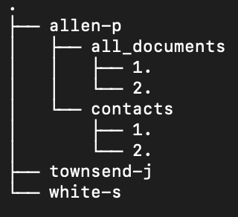
Problem Statement
Process emails starting in an S3 Bucket.
Predict their sentiment.
Summarize the text.
Do spam classification.

Slide 5
Table of Contents
Problem Statement
Pipeline Architecture
Dashboard
Inference Architecture
Highlights & Q&A

Slide 6
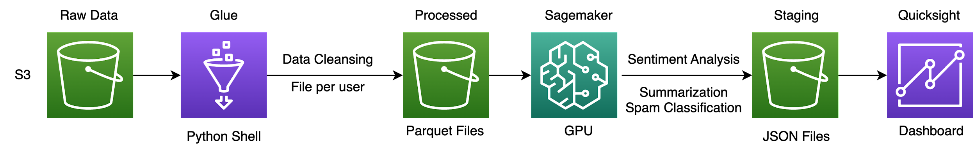
Pipeline Architecture

Slide 7



Transformer Models
We use the Hugging Face transformers library for the NLP inference.
Access to multiple state of the art public models with minimal code changes.
Can integrate our own pytorch or tensorflow models into the pipeline.

Slide 8
Table of Contents
Problem Statement
Pipeline Architecture
Dashboard
Inference Architecture
Highlights & Q&A

Slide 9
Table of Contents
Problem Statement
Pipeline Architecture
Dashboard
Inference Architecture
Highlights & Q&A

Slide 10

Inference Architecture

Slide 11
Table of Contents
Problem Statement
Pipeline Architecture
Dashboard
Inference Architecture
Highlights & Q&A

Slide 12
Highlights
Scalable serverless solution by using Lambda.
Quicksight Dashboard automatically refresh when new data is available.
Easily swap any transformer model.
Enables the usage of medallion architecture by adding a business level aggregates.

Slide 13
Possible Improvements
Save results in parquet -> create Athena table -> Populate Quicksight.
Use Batch for ML processing.
Use Sagemaker Endpoints for inference with larger transformer models.
Separate Lambdas: preprocessing, sentiment, summary and spam (APIGateway 29 seconds timeout).

Slide 14
Q&A

Slide 15
Thank you

